Slide 1

Natural Language Processing Course Python Quick Course
Ivo Bernardo – Udemy Course

Slide 2
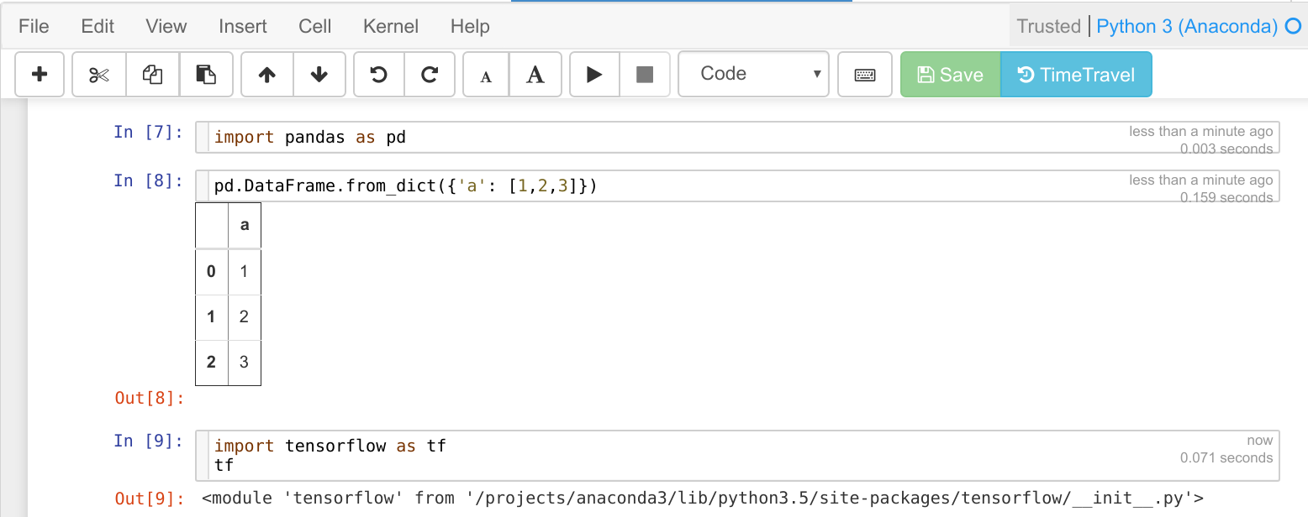
Notebooks Overview
Environment
Notebook Cell
Menu
Execute
Run Status

Slide 3
Python Data Types - Basics
Integers (1,2,3, etc.)
We can perform mathematical operations with them.
Numbers without decimal points are stored as integers.
Floats (1.01, 1.02, 1.03, etc.)
We can perform mathematical operations with them.
Numbers with decimal points are stored as floats.
Strings (‘ABC’, ‘YWZ’, etc.)
We cannot perform mathematical operation with them.

Slide 4






Python Data Types – Basics
An example of how to create an object in Python and checking the type:
Calling a function!
Assignment!

Slide 5
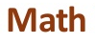
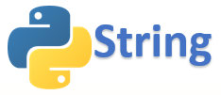





Python Libraries
External code base that we can use with functions and objects that’s not readily available in base Python.
Internal
External
Usage:

Slide 6



Python Lists
Lists are mutable objects that we can use and access by index:
Creating a list called my_list with 6 elements of integer type.
This returns 1 as index on Python start on zero!
This returns 14 as index 3 fetches the object from position 3+1!
This returns a new list with 2 elements as we are applying a slice
They can contain multiple types!

Slide 7


Python Sets
Sets are objects that contain distinct elements
This list has 4 elements
If you call set on my_list you get the returning distinct elements of the list

Slide 8

Python Dictionaries
Key value Pair objects that are extremely flexible in Python:
Dictionary with 4 elements that maps the
Name of the month to the respective number
Accessing the key returns the value of the dictionary
Important attributes:
.items()
.values()
.keys()

Slide 9

Python Tuples
Paired object that can be accessed by it’s index:
Creating a list of tuples
Accessing the first tuple

Slide 10
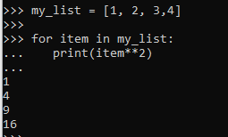
Python Control Flow – For Loops
Python control flow can help you to control how your code flows
Iterating through each element in my_list and
printing the element times 2

Slide 11
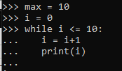
Python Control Flow – While Loops
Python control flow can help you to control how your code flows
While is similar to for but you have to explicitly
Increment the element that is evaluated
on the condition

Slide 12
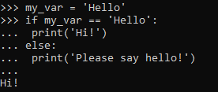
Python Control Flow – If Statements
Python control flow can help you to control how your code flows
If statements help you to evaluate conditions
and run the code similar to a “tree”

Slide 13


Python Functions
Functions enable you to create code that you can reuse and pass parameters (if you want to)
Defining the function say_hi that takes the argument name.
Calling the function with the argument John
If you want the function to return something you have to call return at the end of the function.

Slide 14




Numpy Overview
Linear algebra library that enables you to manipulate arrays inside Python
1D array
2D arrays
nD arrays

Slide 15
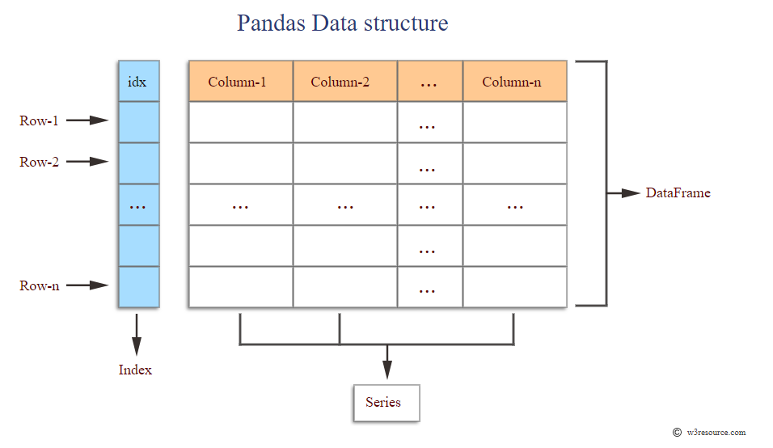
Pandas Overview
Panel Data Library that enables you to manipulate data similar to a table
Selector methods:
.iloc selects by index by position (0, 1, 2, ..)
.loc selects by index name

